Slide 1

Qantum Computing Algorithms

Slide 2
Agenda
Qubits
Logic Gates
Quantum Properties
Quantum Algorithms
Challenges of Qubits
Noisy Intermediate Scale Quantum Computers (NISQ)
Applications
Final tips & takeaways

Slide 3

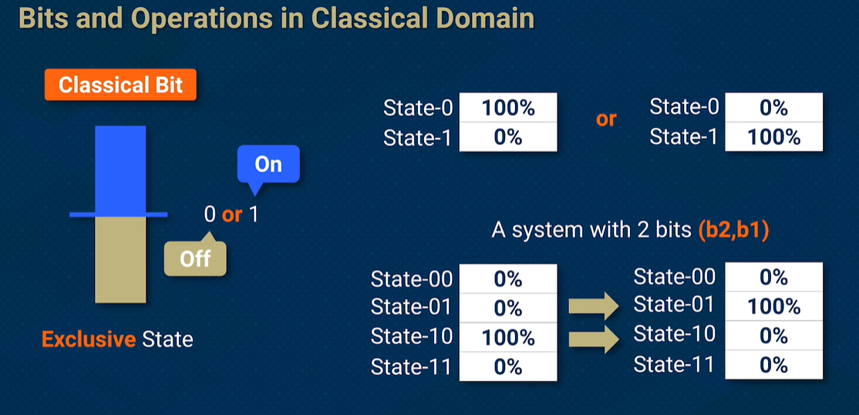
Classical bits
Represented as 0 or 1
Implemented as electrical voltage or light pulses
Not as efficient for certain complex computations
Limited scalability for high performance computing

Slide 4
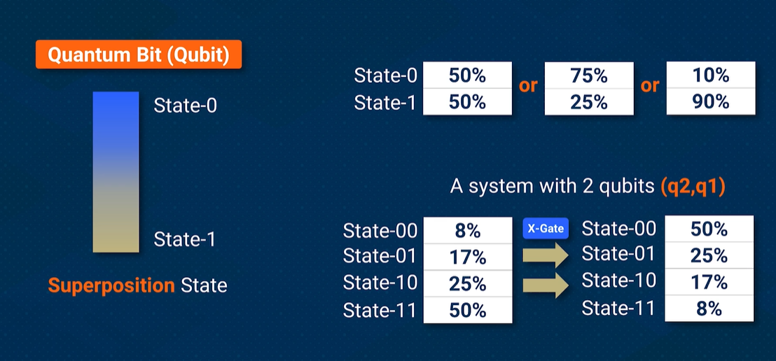
Quantum bits
Fundamental unit of Quantum information
Qubits exist in a superposition
Can be more efficient for certain complex computations
Implemented through different quantum systems such as Superconducting circuits, trapped ions, photon-based qubits

Slide 5
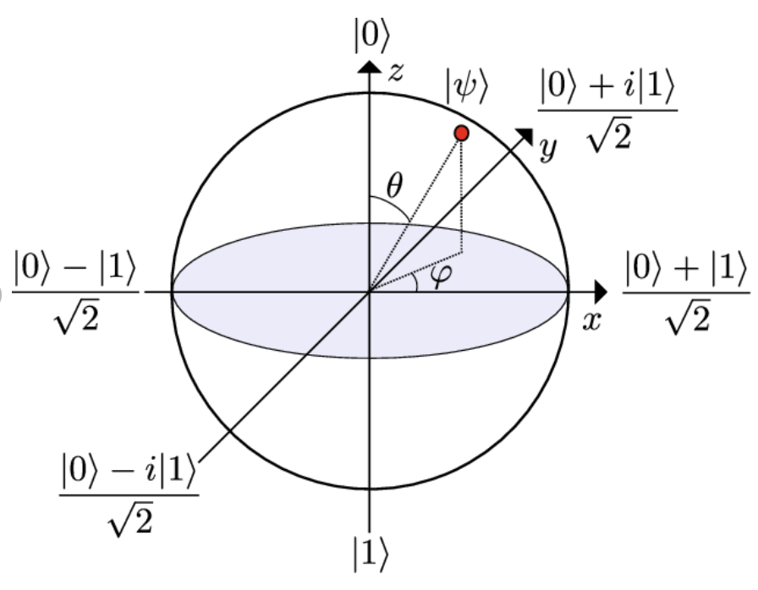
Key Properties of Quantum Bits
Superposition
Can be 0 or 1 simultaneously
Entanglement
Qubits can be linked affecting other qubits instantaneously
Quantum Interference
Probability amplitudes can be manipulated for computation

Slide 6
Differences between Quantum and classical bits
A 4-bit classical system can represent 1 of 16 states at a time
1 bit only contains one unit of information
Power increases linearly with number of bits
A 4-bit Quantum system can represent all 16 states at simultaneously
Due two entanglement one qubit can equal 2 bits of classical information
Power increases exponentially with number of qubits

Slide 7

Quantum Logic gates

Slide 8
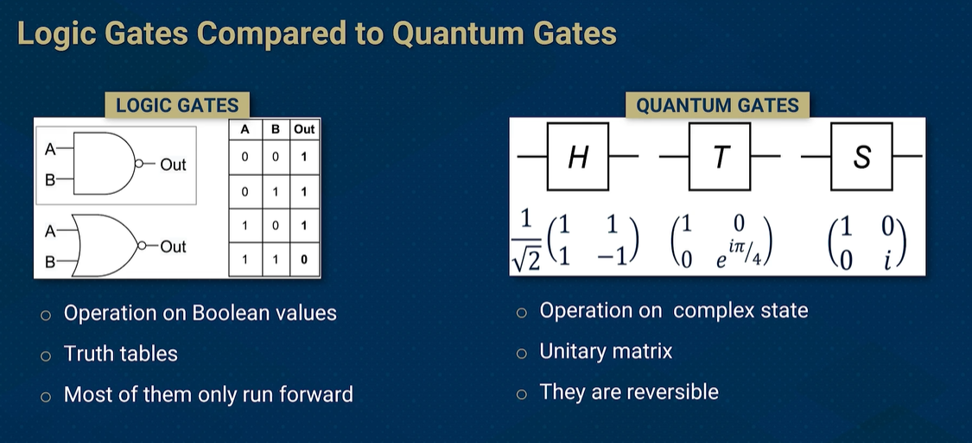
Quantum vs Classical Gates

Slide 9
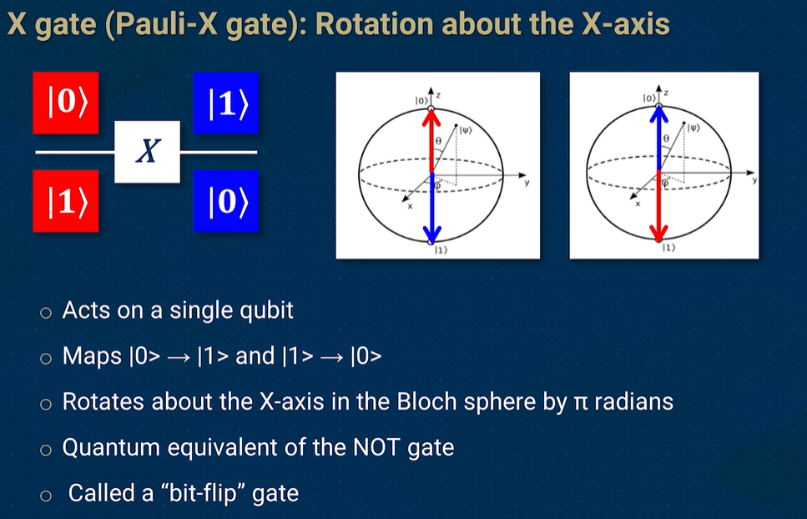
Pauli – X Gate

Slide 10
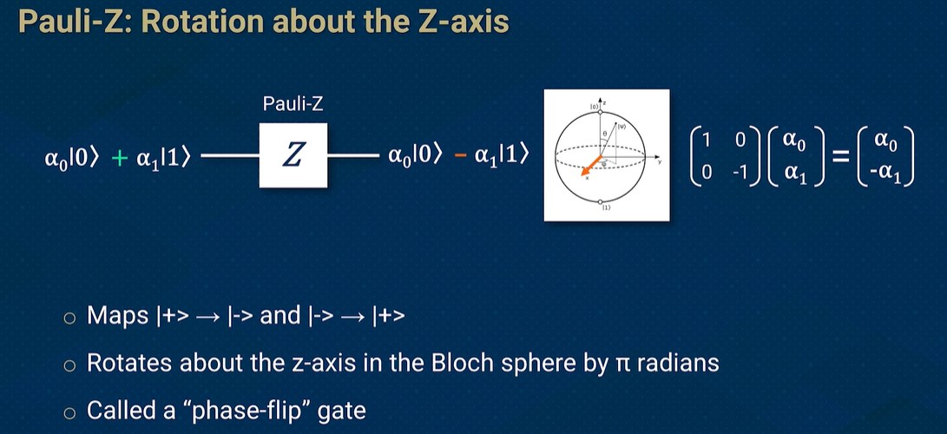
Pauli – Z Gate

Slide 11
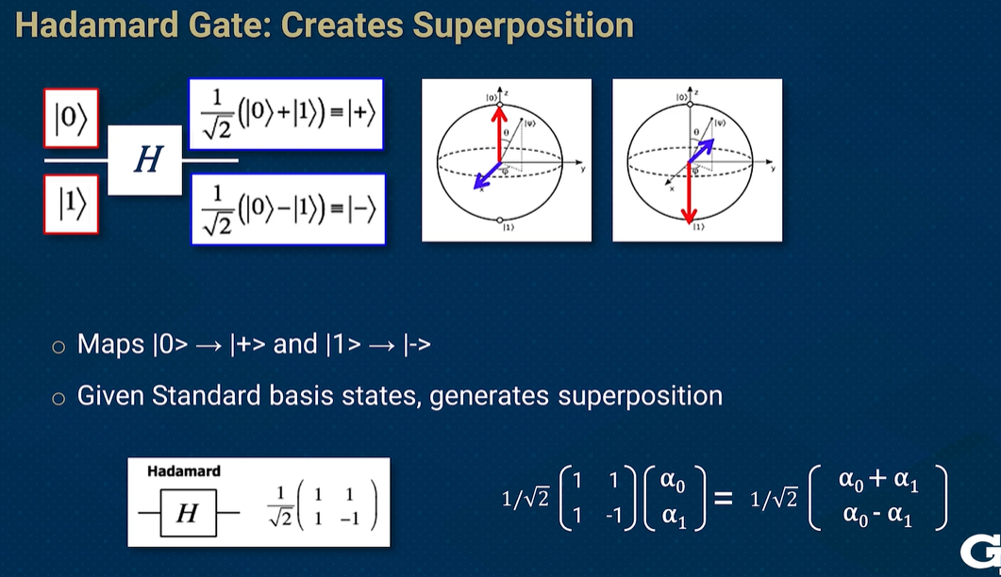
Hadamard Gate

Slide 12
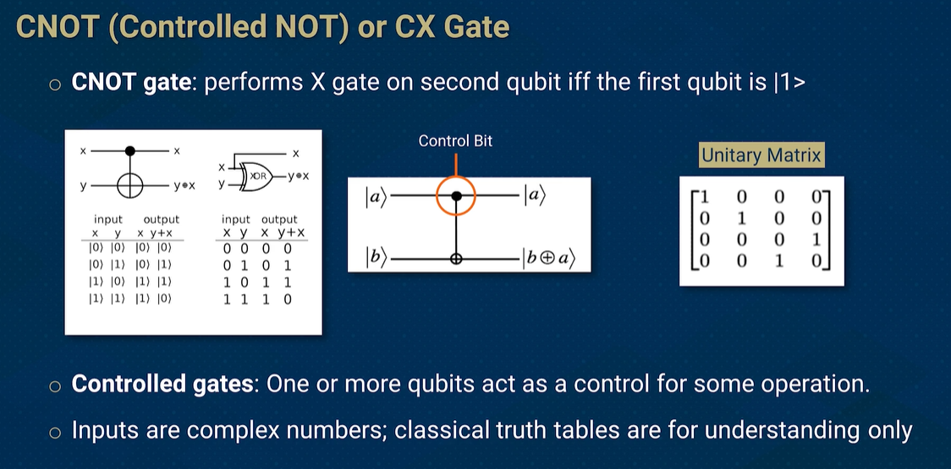
CNOT Gate

Slide 13
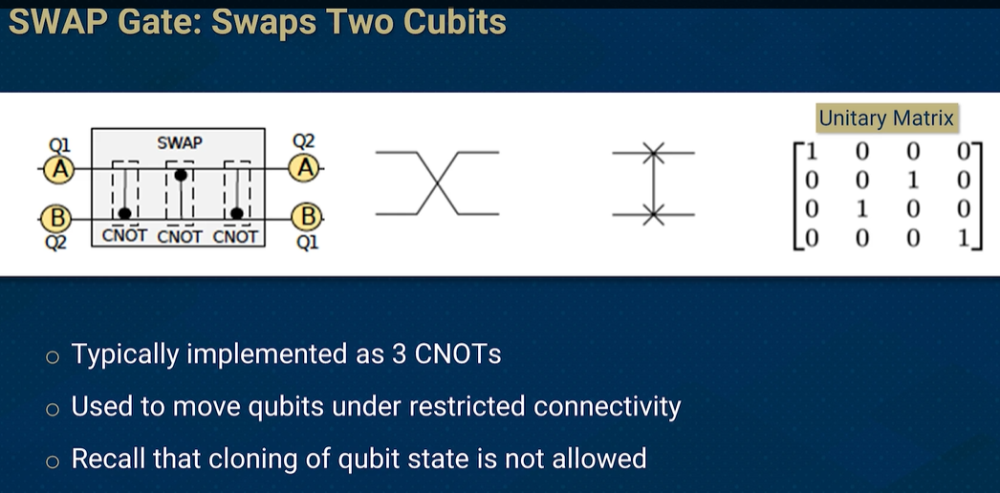
Swap Gate

Slide 14
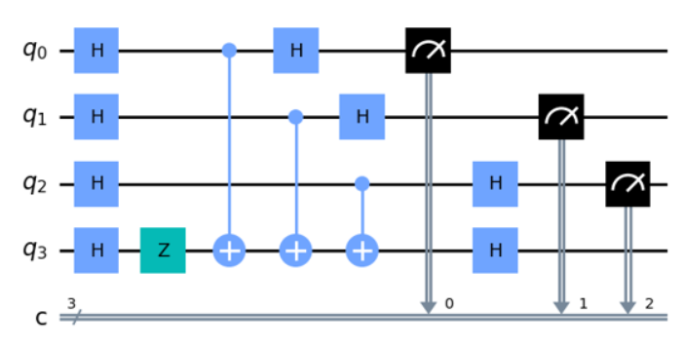
Representing a Quantum Circuit

Slide 15
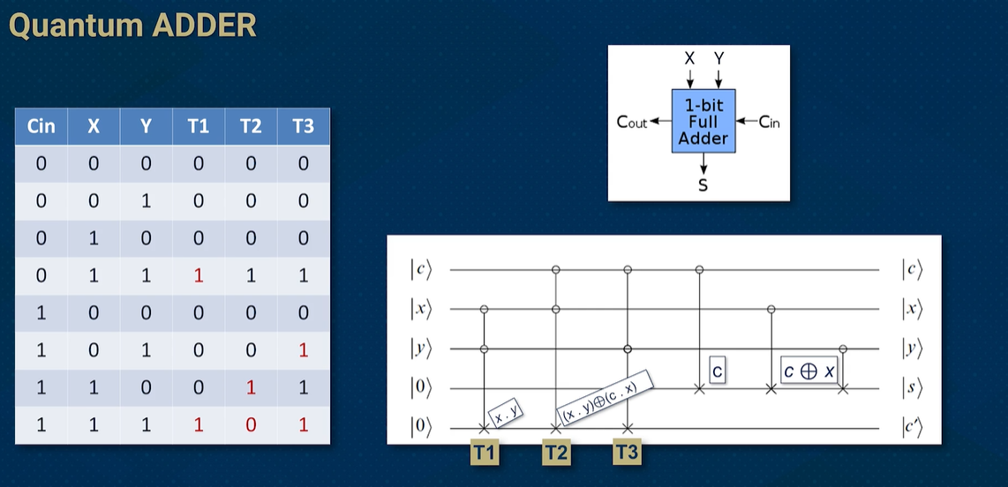
Adder circuit

Slide 16
Quantum Properties

Slide 17
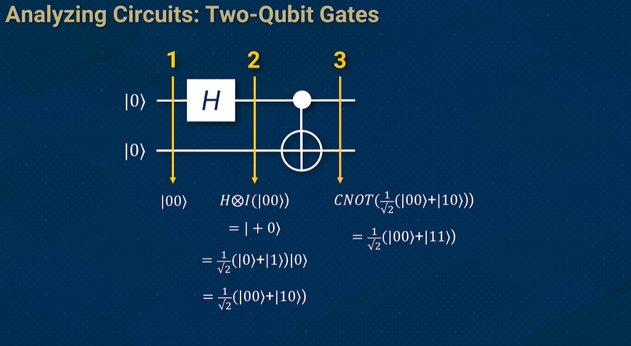
Entanglement
Entanglement is generated using microwave pulses applied through control lines.
A Controlled-NOT (CNOT) gate links two qubits, making them entangled.
measuring one instantly sets the other’s state
Entanglement is fragile and can be lost due to environmental interference

Slide 18
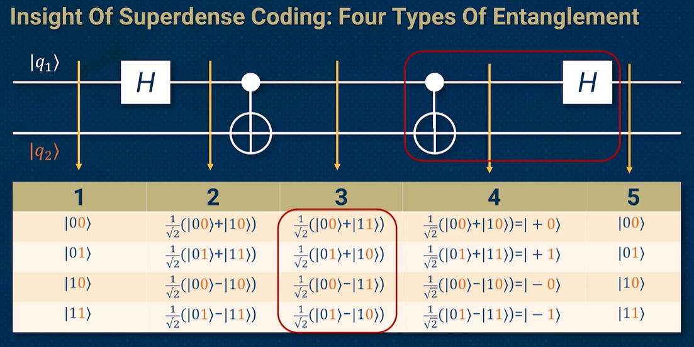
Superdense Coding
A quantum communication protocol that allows the transmission of 2 classical bits using only 1 qubit.
3 Steps:
Entanglement: Shared entangled qubits between Alice and Bob.
Encoding: Alice encodes 2 classical bits in 1 qubit.
Decoding: Bob decodes the information by measuring the entangled qubits.

Slide 19
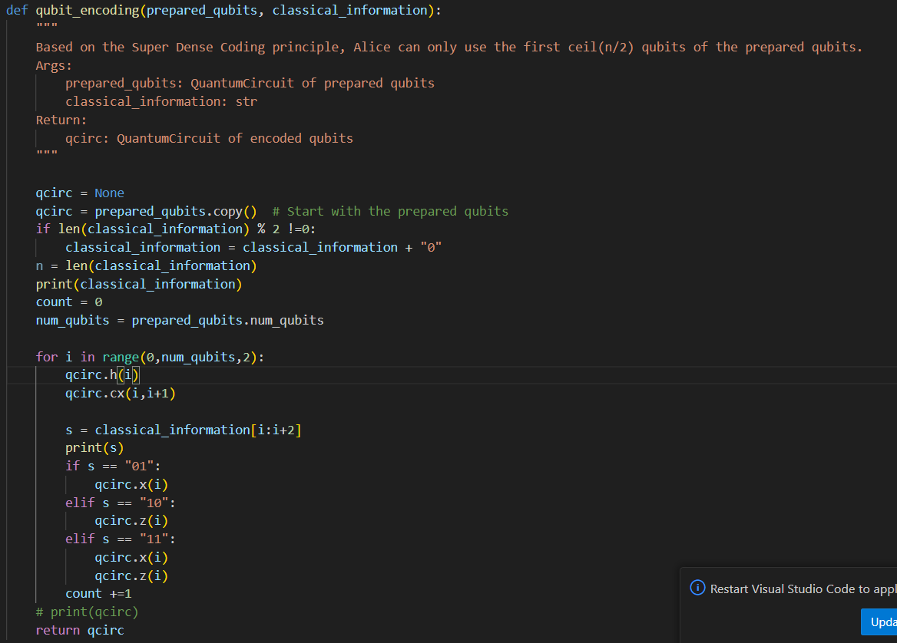
Superdense Coding: Encoding
Taking in a string of classical information and looping through it, we send two bits of information at a time
Encoding:
00: No operation (Identity gate).
01: Apply X gate.
10: Apply Z gate.
11: Apply XZ gate.

Slide 20
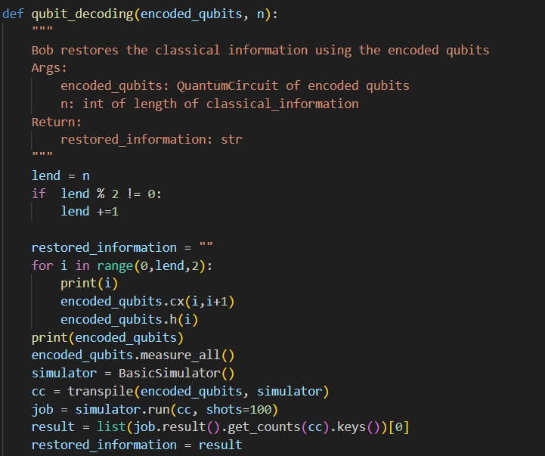
Superdense Coding: Decoding
Taking in the Encoded bits we apply a CNOT gate on q i and q i+1 to get the decoded message
To keep the order of the message all output bits were placed after their encoded bit
For a message of length n only n/2 encoded bits of information need to be sent

Slide 21
Quantum Algorithm's

Slide 22
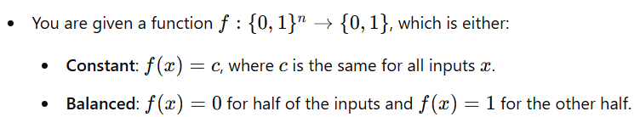
Constant or Balanced Problem
Classical Solution:
In the classical case, you would need to evaluate the function f at least 2^n/2 + 1 times in the worst case to determine if it's constant or balanced. Since one more query would be needed to see if more than half are either 0 or 1
Quantum Solution:
In the Quantum case, you would need to evaluate the function once.

Slide 23
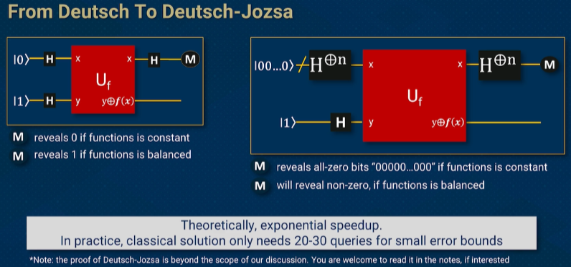
Deutsch-Joza Algorithm

Slide 24
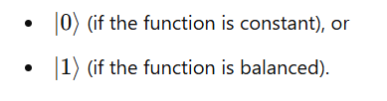
Deutsch-Joza Algorithm Steps
3.After the oracle step, the quantum state is now a superposition of all possible inputs, each carrying information about whether the function f(x) is 0 or 1 for that specific input
4. Interference with Hadamard:
After applying the oracle, you perform another round of Hadamard gates on the first n qubits.
This step induces interference: it causes the amplitudes of different states to combine in such a way that when you measure the qubits, the quantum state collapses to one of two outcomes:
1. Quantum Superposition and Parallelism:
You start by initializing your system in a superposition of all possible input values by applying a Hadamard gate to all the qubits, putting the quantum state into an equal superposition of all possible inputs.
2. Oracle Query:
The quantum oracle applies the function f(x) to each possible qubit, modifying the auxiliary qubit based on the function's output. Importantly, this does not require evaluating the function multiple times in sequence; it's done in a single operation.

Slide 25
Quantum VS Classical Algorithm's

Slide 26
Bad For
Simple Arithmetic and Classical Computation
Problem: Basic calculations or tasks that don’t involve complex or large datasets.
Why Not Quantum: Classical computers are still more efficient for simple, non-parallelizable tasks like addition, subtraction, or small-scale multiplications.
Problems with No Quantum Advantage
Problem: Problems that don’t involve large data sets or don't benefit from superposition or quantum parallelism.
Why Not Quantum: For many everyday problems, quantum computers may offer no speedup and would be overkill.
Problems that Require Error-Free Computation
Large-Scale Classical Cryptography (Post-Quantum Cryptography)
Problem: Classical encryption systems (e.g., AES, hash functions).
Why Not Quantum: Quantum computers pose a threat to RSA and other public-key systems but are not yet a practical threat to symmetric-key cryptography like AES. Classical solutions remain effective for these problems in the current state of quantum computing.

Slide 27
Problem's with Quantum Algorithms
1. Quantum Decoherence
Qubits lose their quantum state due to interactions with the environment.
Short coherence times lead to errors before computations finish.
2. Gate Imperfections
Quantum gates (e.g., CNOT, Hadamard) are not perfectly implemented.
Errors occur due to hardware limitations in applying precise operations.
3. Crosstalk Between Qubits
Nearby qubits unintentionally interfere with each other.
Causes unwanted entanglement, leading to computational errors.
4. Measurement Errors
Reading out qubits introduces noise.
Errors occur when 𝑞𝑢𝑏𝑖𝑡 |0⟩ is misread as |1⟩ (or vice versa).
5. External Noise & Temperature Sensitivity
Quantum processors operate near absolute zero (~15mK).
Even tiny vibrations or electromagnetic interference can disrupt qubits.

Slide 28
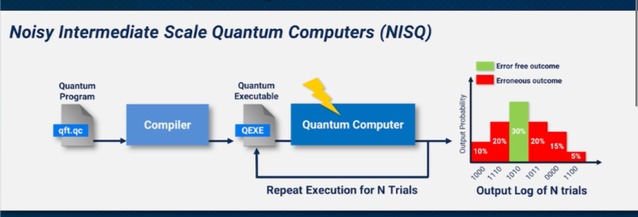
Noisy Intermediate Scale Quantum
current generation of quantum computers that are limited in size, prone to significant errors due to environmental noise.
Running the same quantum circuit thousands or millions of times helps identify the most likely correct answer.
Currently the top end of quantum computers have around a 1180 qubits (Atom Computing)

Slide 29
Quantum Algorithm Use Cases

Slide 30
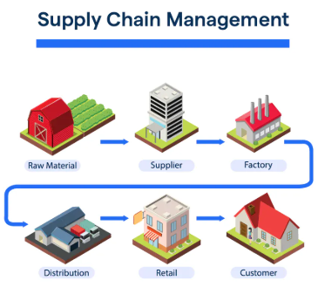
Use Casses
Supply Chain Management - Route Optimization
Use Case: Quantum algorithms can optimize delivery routes, minimizing time and fuel costs in logistics.
Algorithm: Quantum Approximate Optimization Algorithm (QAOA), Grover’s Algorithm
Benefit: Finding optimal routes faster by processing large datasets more efficiently, crucial for industries like logistics, transportation, and e-commerce.

Slide 31

Use Casses
Drug Discovery
Use Case: Quantum computers can simulate molecular interactions at a level of detail that is impossible with classical computers, aiding in faster drug discovery.
Algorithm: Quantum Simulations (e.g., Variational Quantum Eigensolver (VQE))
Benefit: Acceleration of finding promising drug candidates, reducing time and cost in the pharmaceutical industry.

Slide 32

Thank you

Slide 33
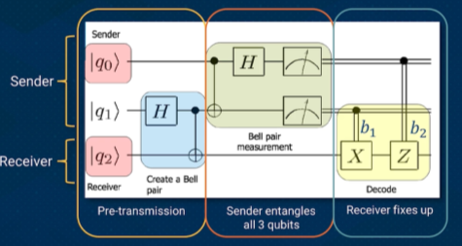
Teleportation
1. Entanglement Setup
Qubits A & B are entangled, linking their states across any distance.
A third qubit (C) holds the quantum state to be teleported.
2. Bell Measurement & Classical Communication
Alice measures qubits C & A, collapsing their states into a known classical result.
She sends two classical bits to Bob.
3. Quantum State Reconstruction
Bob applies a quantum operation on qubit B based on Alice’s message.
This restores the original state from qubit C onto B.

